Slide 1


Mental Health Monitoring with a Chat Bot
- Tejaswanth Maram (19BEC1019) - Arnav Kumar Roy (19BEC1457) - Shreyansh Kumar (19BEC1246) - G S N Nihith (19BEC1097)

Slide 2

Abstract:
There is enough evidence to prove that overall physical, psychological and communal welfare of a human being is predominantly dependent on their mental health.
Depression is a common illness worldwide, with more than 264 million people affected. Close to 800 000 people die due to suicide every year. Suicide is the second leading cause of death in 15-29-year-olds.
Thus, early recognition and mediation in addressing issues regarding it is of utmost importance.
Individualized and ubiquitous sensing technologies such as smartphones, smartwatches etc. allow continuous tracking and gathering of data in an undisturbed and low-profile manner.
Sentimental Analysis using Natural Language Processing has been proposed to be applied to the collected data to monitor.
This project aims at gathering the data from the user through a chatbot which will be analysed by the system to prepare and publish the report to the user to keep them aware of their mental health.

Slide 3
Literature Survey
[1] Doaa Mohey El-Din Mohamed Hussein(January 2016). Analyzing Scientific Papers Based on Sentiment Analysis (First Draft).​
Doaa Mohey El-Din Mohamed Hussein proposed a new technique to analyze online reviews in the scientific research domain called: "Sentiment Analysis Of Online Papers" (SAOOP). SAOOP aims at supporting researchers and saving their time and efforts by enabling them to report the total evaluation for the papers.​
​
[2] Akshi Kumar, Teeja Mary Sebastian(July 2012).Sentiment Analysis on Twitter. International Journal of Computer Science Issues 9(3):372-378​
Akshi Kumar and Teeja Mary Sebastian proposed and investigated a paradigm to mine the sentiment from a popular real-time microblogging service, Twitter, where users post real time reactions to and opinions about “everything”. In this paper, they expound a hybrid approach using both corpus based and dictionary based methods to determine the semantic orientation of the opinion words in tweets.​
[3]Changliang Li, Bo Xu,Gaowei Wu, Sk He, Guanhua Tian, Yujun Zhou(May 2015).Parallel Recursive Deep Model for Sentiment Analysis.Conference: Pacific-Asia Conference on Knowledge Discovery and Data Mining​
Changliang Li, Bo Xu,Gaowei Wu, Sk He, Guanhua Tian and Yujun Zhou[3] focused on the task of predicting sentiment label distribu-tions, which aims to predict sentiment label distributions on phrase and sentence level. There has recently been considerable progress in predicting sentiment label distributions.​

Slide 4
Literature Survey
[4] R. Prabowo, and M. Thelwall, ―Sentiment analysis: A combined approach‖, Journal of Informetrics, Vol. 3, No. 2, pp. 143-157, 2009.
This paper combines rule-based classification, supervised learning and machine learning into a new combined method. This method is tested on movie reviews, product reviews and MySpace comments. The results show that a hybrid classification can improve the classification effectiveness in terms of micro- and macro-averaged F1. F1 is a measure that takes both the precision and recall of a classifier’s effectiveness into account.
[5] C.N. Chandra, S. Gupta, and R. Pahade, ―Sentiment analysis and its challenges‖, International Journal of Engineering Research & Technology, Vol. 4, No. 03, pp. 968-970, 2015
This paper deals with recently proposed algorithms, approaches and its applications briefly. The main goal of this paper is to provide a complete description of Sentiment Analysis or Opinion Mining technique and the challenges faced by it. We also include the social issue regarding manipulation, privacy and economic impact faced during the development of information seeking services.

Slide 5
Literature Survey
[6] X. Fang, and J. Zhan, ―Sentiment analysis using product review data‖, Journal of Big Data, Vol. 2, No. 1, p.5, June 2015, doi: 10.1186/s40537-015-0015-2
International Journal of Engineering Research & Technology, Vol. 4, No. 03, pp. 968-970, 2015
This paper is aimed to tackle the problem of sentiment polarity categorization, which is one of the fundamental problems of sentiment analysis. A general process for sentiment polarity categorization is proposed with detailed process descriptions. Data used in this study are online product reviews collected from Amazon.com. Experiments for both sentence-level categorization and review-level categorization are performed
[7] P. Arora, A. Bakliwal, and V. Varma, ―Hindi subjective lexicon generation using WordNet graph traversal, International Journal of Computational Linguistics and Applications, Vol. 3, No. 1, pp. 25-39, June 2012.
In this paper, we present a graph based method to build a subjective lexicon for Hindi language, using WordNet as a resource. Our method takes a pre-annotated seed list and expands this list into a full lexicon using synonym and antonym relations. We show two different evaluation strategies to validate the Hindi Lexicon built. Main contribution of our work 1) Developing a Subjective lexicon of adjectives using Hindi WordNet. 2) Developing an annotated corpora of Hindi reviews.

Slide 6
Literature Survey
[8] Batrinca, and P.C. Treleaven, ―Social media analytics: a survey of techniques, tools and platforms‖, Ai & Society, Vol. 30, No. 1, pp. 89-116, 2015.
This paper refers to the application of natural language processing, computational linguistics and text analytics to identify and extract subjective information in source materials. Text analytics—involves information retrieval (IR), lexical analysis to study word frequency distributions, pattern recognition, tagging/annotation, information extraction, data mining techniques including link and association analysis, visualization and predictive analytics.
[9] Y. Kim, ‖Convolutional neural networks for sentence classification.‖, In Proceedings of the 2014 Conference on Empirical Methods in Natural Language Processing (EMNLP) , Doha, Qatar, August 2014, doi:/10.3115/v1/D14-1181.
This paper report on a series of experiments with convolutional neural networks (CNN) trained on top of pre trained word vectors for sentence-level classification tasks. We show that a simple CNN with little hyperparameter tuning and static vectors achieves excellent results on multiple benchmarks. Learning task-specific vectors through fine-tuning offers further gains in performance.

Slide 7
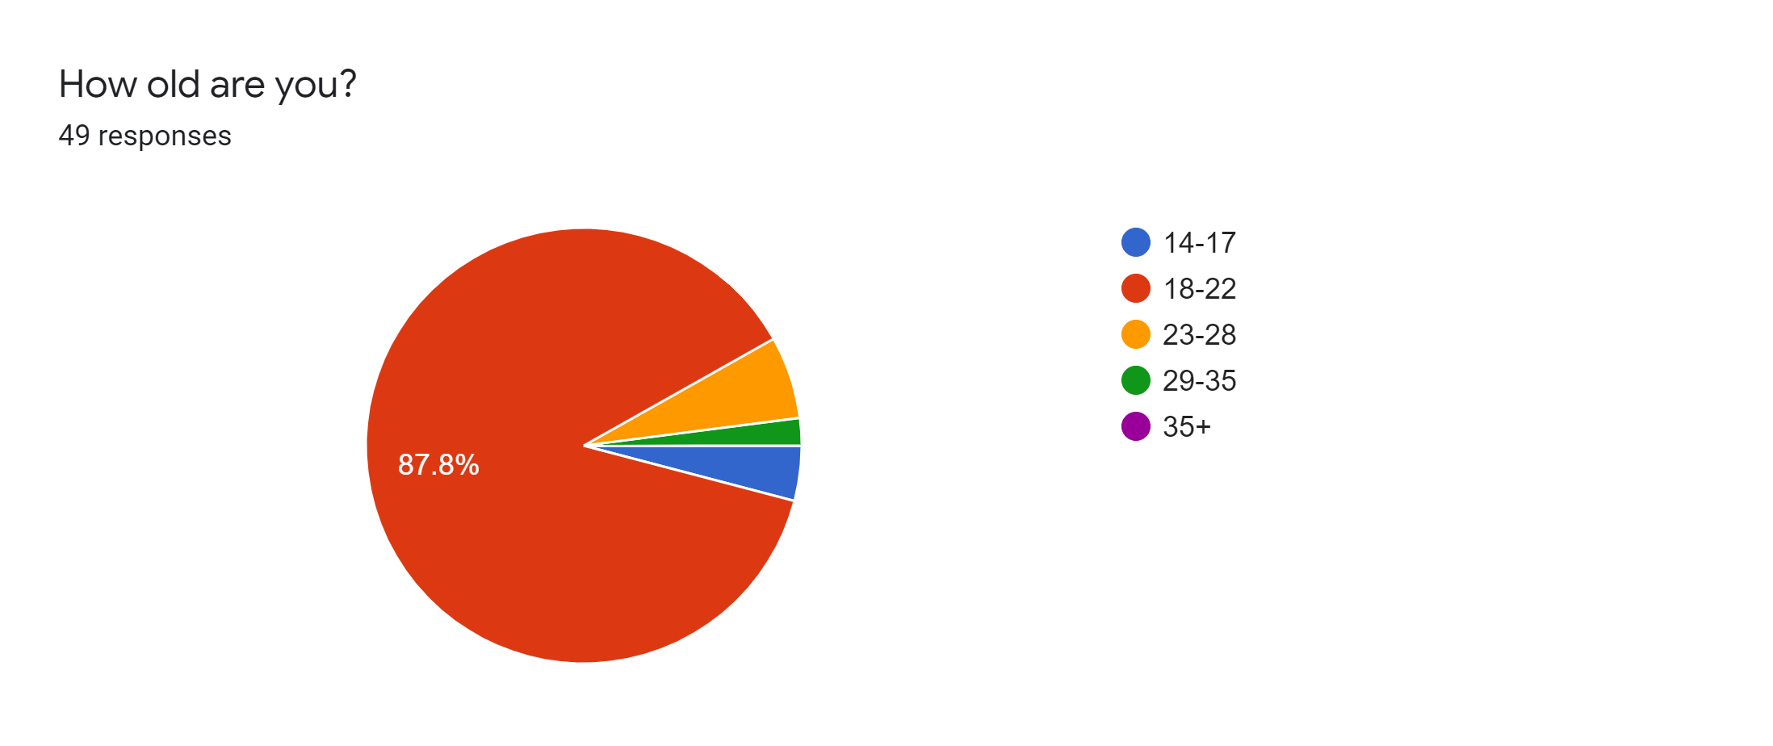
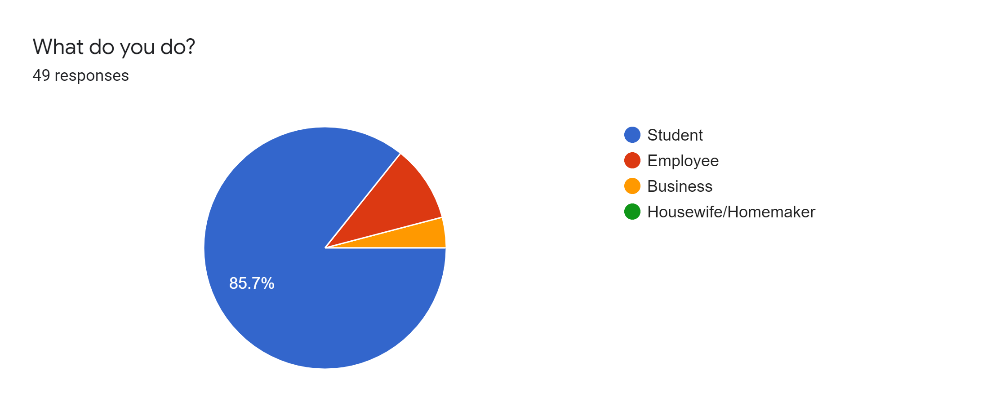
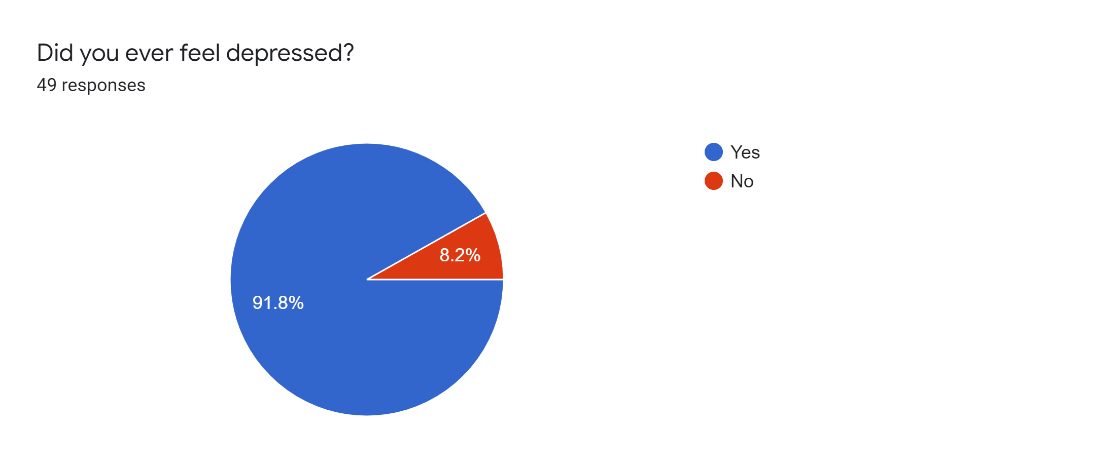
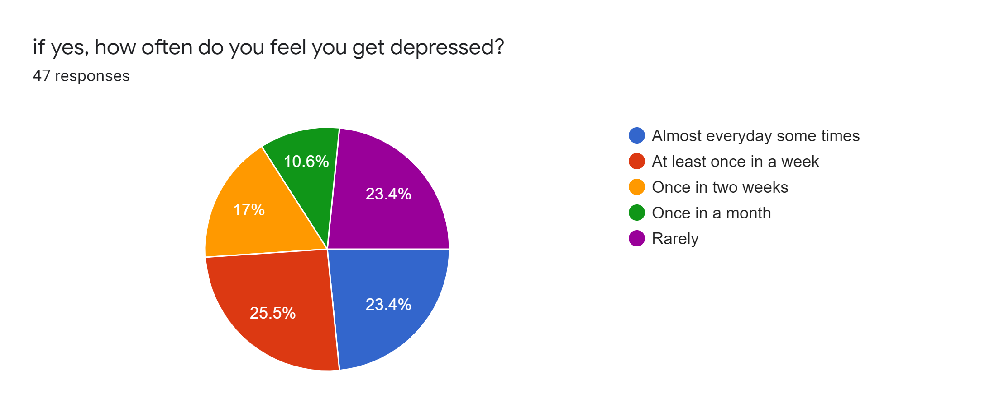
Survey:

Slide 8
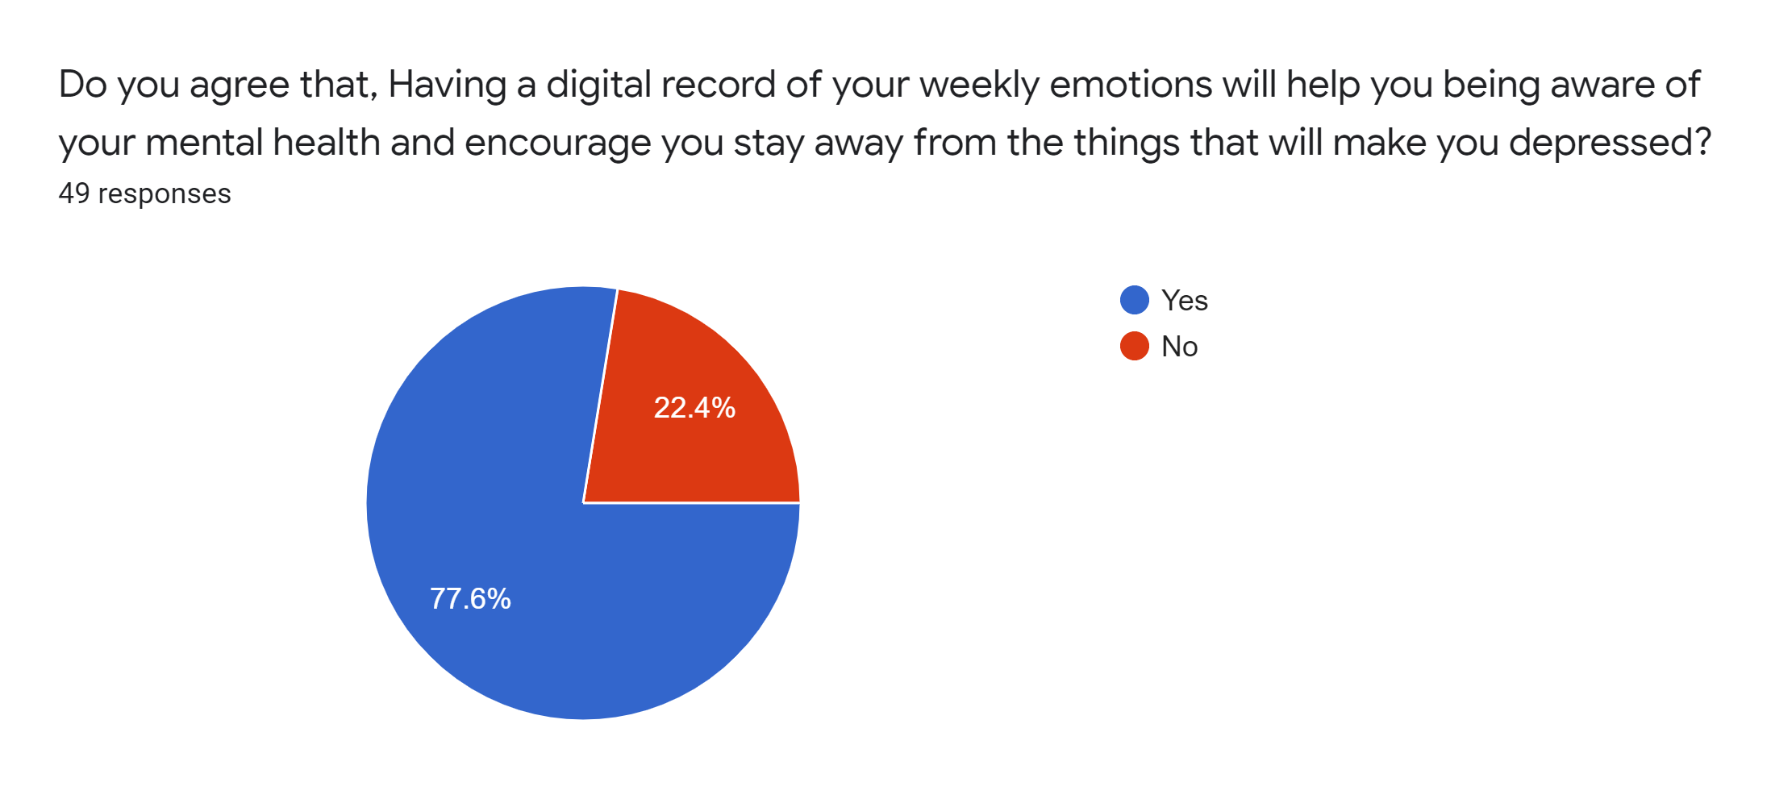
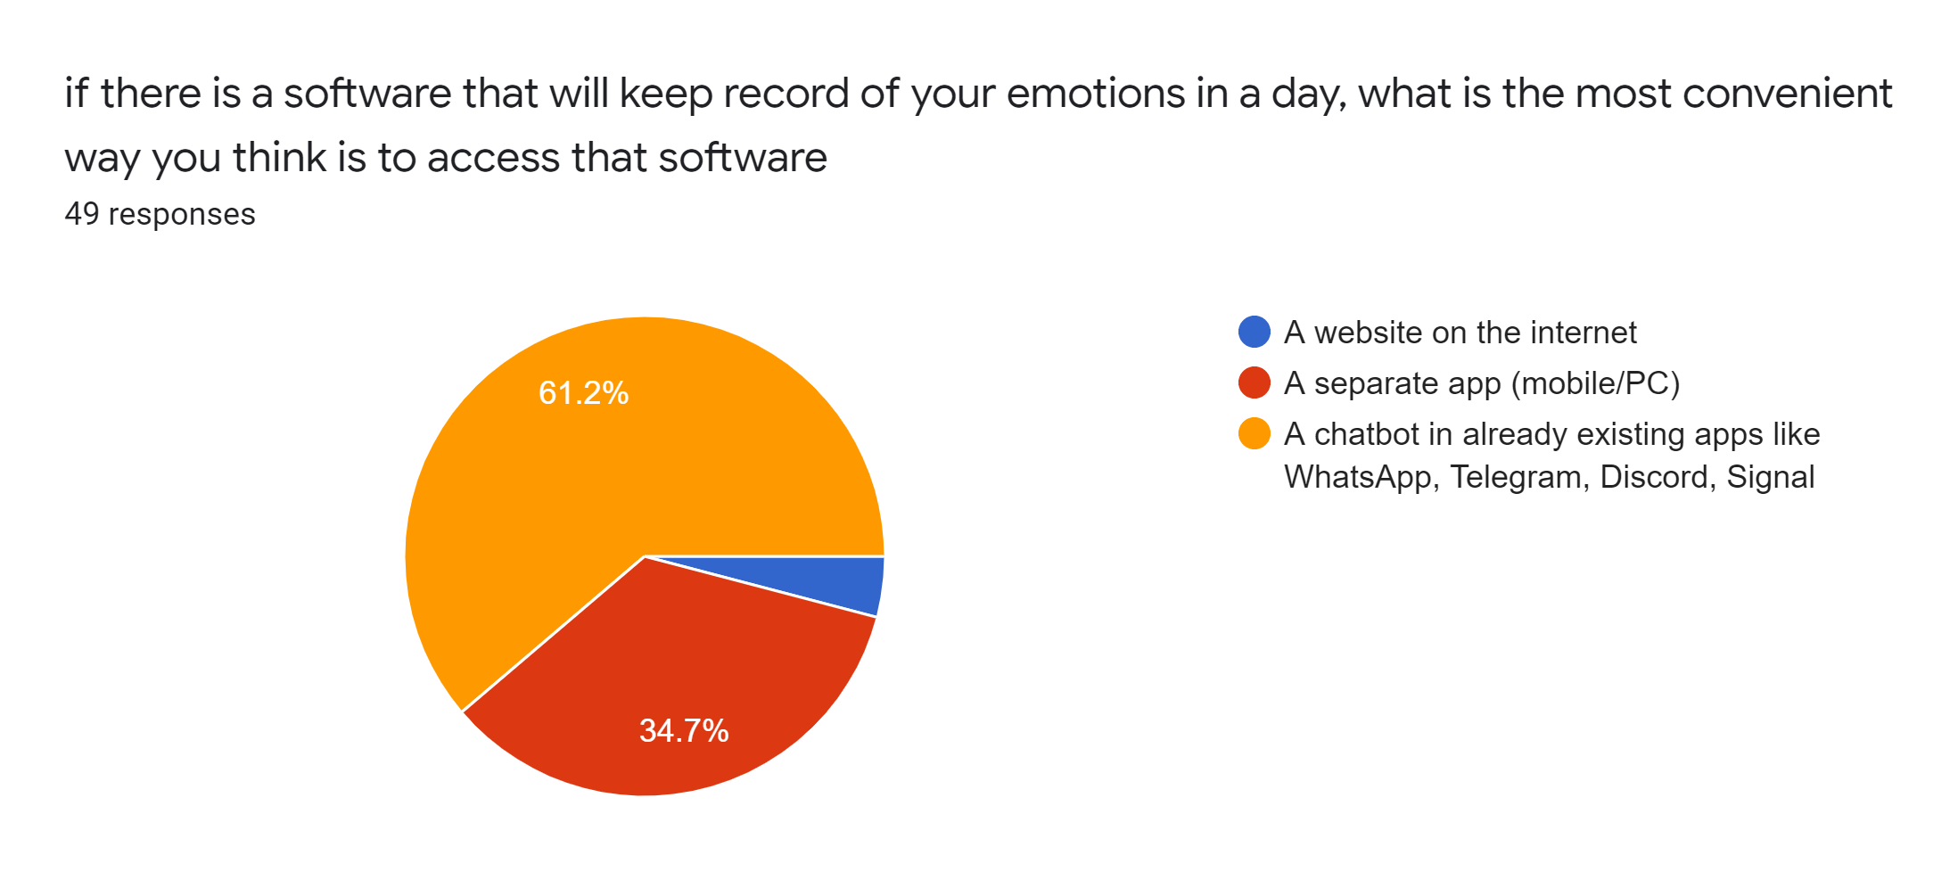
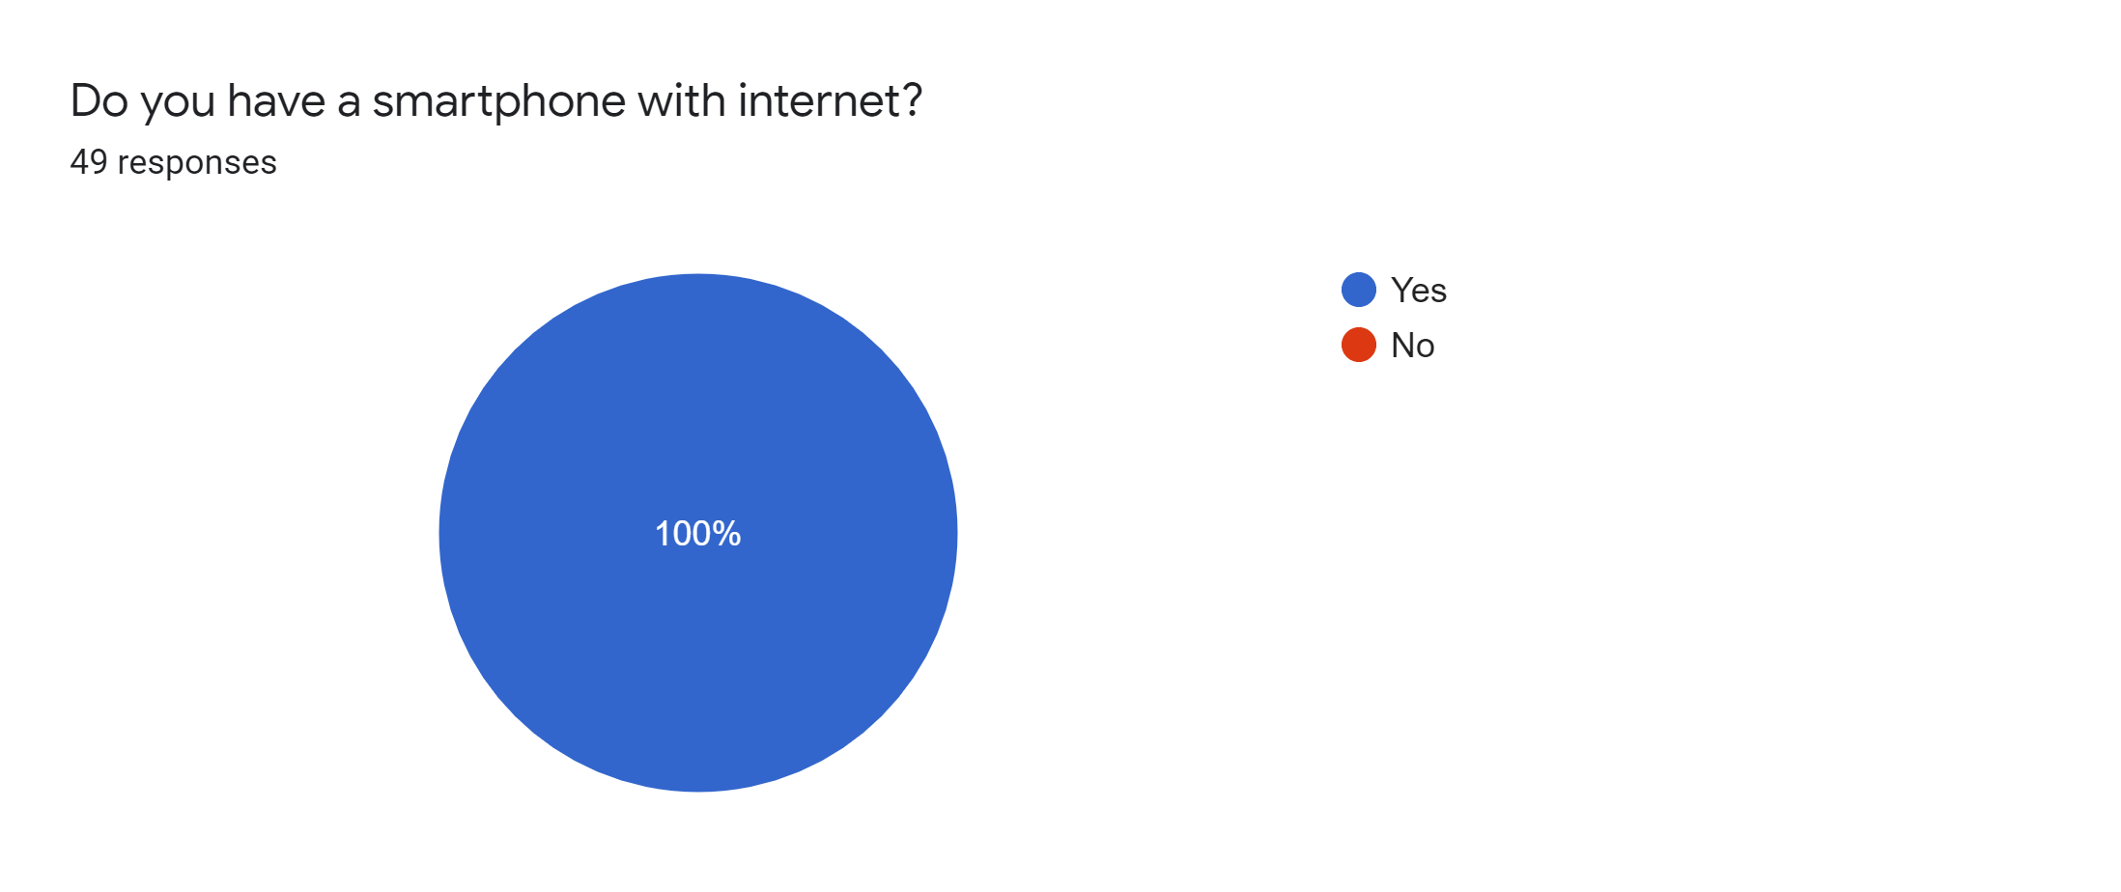
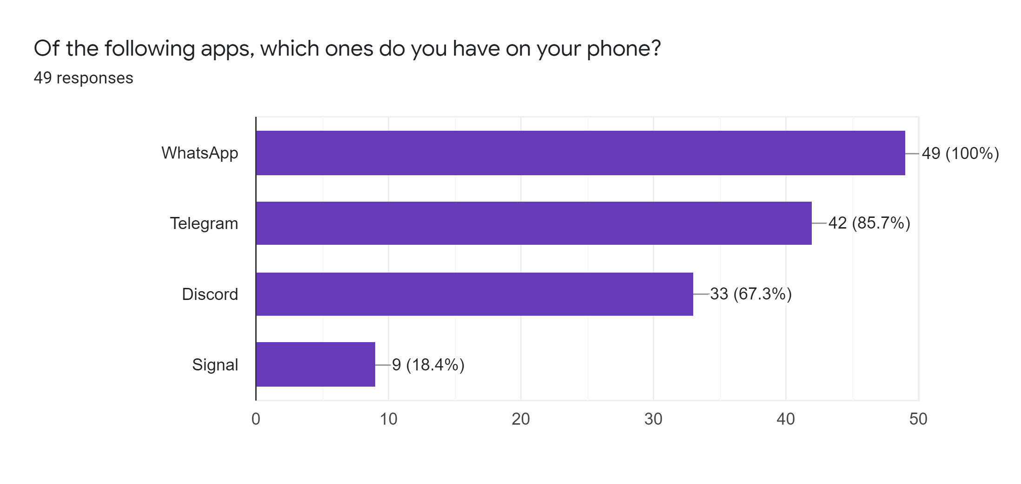
Survey:

Slide 9
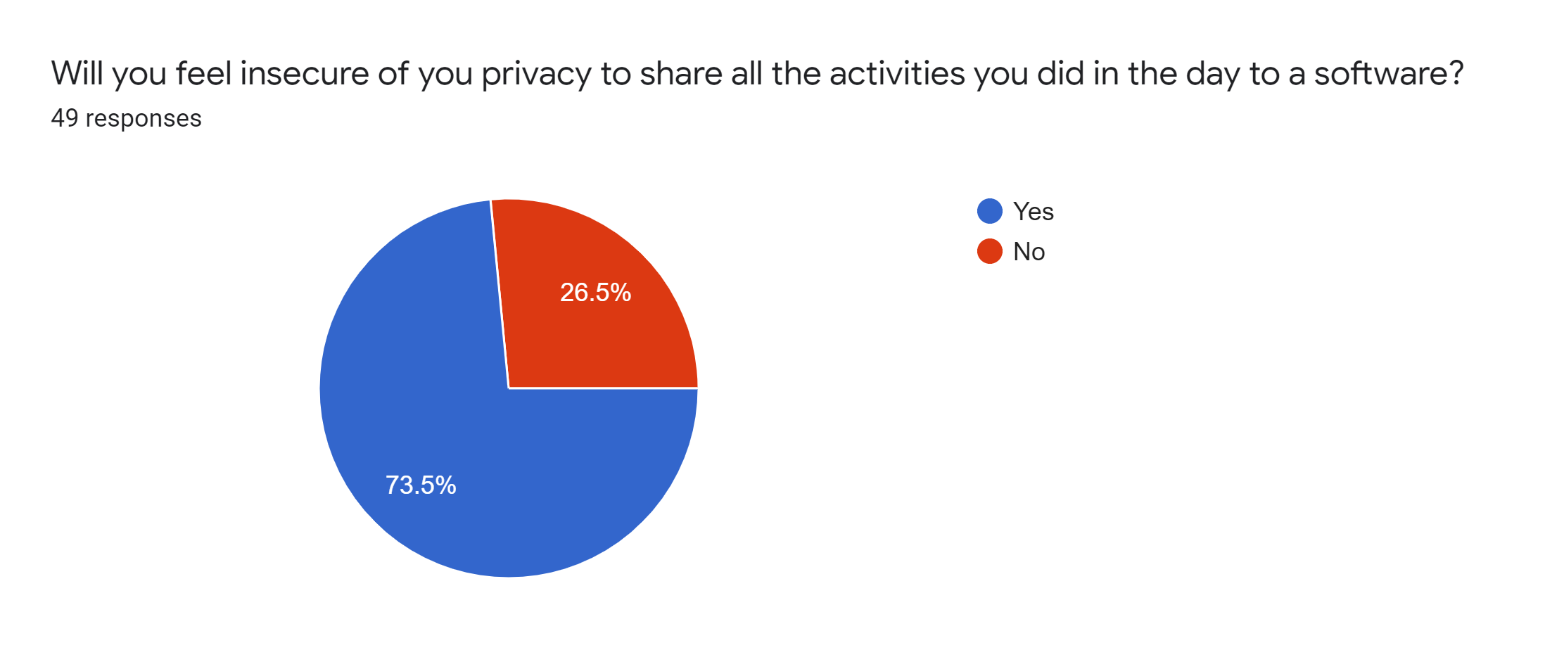
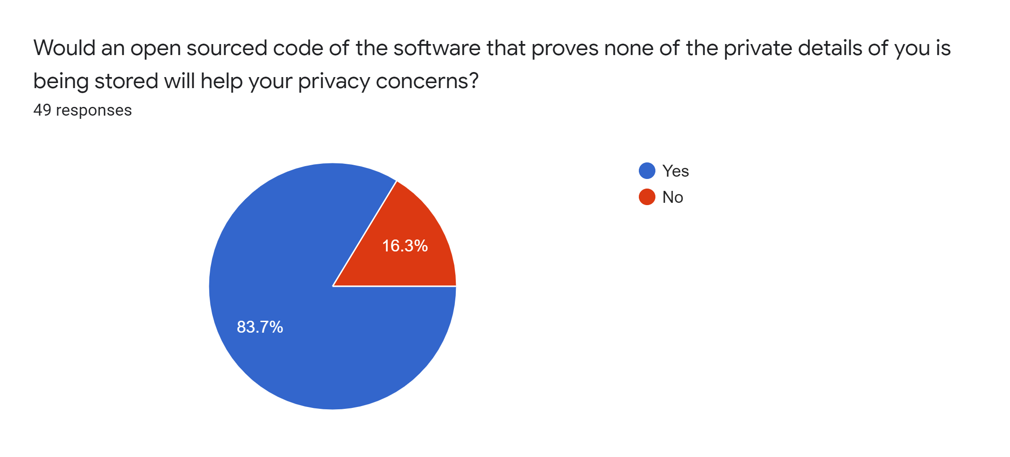
Survey:

Slide 10
Proposed System:
We propose to design a mental health monitoring system using Telegram chatbot which interacts with the user and makes observations on their conversation patterns.
The system essentially tries to understand the emotional and mental state of the user based on the words they use to converse with the chatbot.
The system then keeps a track of the changes of emotional and mental state of the person to make a weekly and monthly report on the mental health of the user.
This system can be very crucial in keeping a track of the user to let them know how they are doing mentally.

Slide 11
Features:
A chatbot which wishes the user everynight and gathers data by asking about their day.
Telegram app is used for the Chatbot implementation
Text cleaning and Text mining to process that uses to natural language processing to structure the data
Barplot and Wordcloud based on the most frequent words in the data
Sentimental analysis and emotion classification using syuzhet package
Chatbot feature automated messaging and replying with sending photos and text

Slide 12



Illustration:
Chat Bot
Chat Bot
Hey! how's ur day?
Hey! how's ur day?
10:30 pm
10:30 pm
Here we are another day in lockdown at the moment all the days seem to merge into one. It is a reallly strange time for us all as I am working in my bedroom doing my schoolwork for the upcoming senior year starting tomorrow, …..............
Here we are another day in lockdown at the moment all the days seem to merge into one. It is a reallly strange time for us all as I am working in my bedroom doing my schoolwork for the upcoming senior year starting tomorrow, …..............
10:35 pm
10:35 pm
10:36 pm
10:36 pm
Wish you a great day tomorrow, good night!
Wish you a great day tomorrow, good night!
10:36 pm
10:36 pm

Slide 13

Modules:
tm library snowball library
telegram.bot
Automated greetings by chatbot
Receiving text from Chat Bot
Cleaning and pre-processing the text
Building Term Document Matrix
Rcolorbrewer library ggplot library
nrc lexicon
syuzhet library
wordcloud library
Pictorial Representations
Emotion Classification
Calculating Sentiment Scores
Pictorial Representations
Repeat
Send the results back through chatbot
Store the Results for monthly report

Slide 14


Programming Language
Chat Bot Platform

Slide 15
Progress:
Methods for cleaning and preprocessing of the text have been explored and implemented on a sample text file.
The term document matrix was obtained, and the results are depicted in pictorial representations.
Future Works:
A Telegram bot has to be created.
The cleaning and preprocessing code has to be applied to the received text from chatbot.
Sentiment analysis shall be done to get the sentiment scores of the received text.​
After that we will classify the emotion of the user using the above obtained sentiment scores​
All the results will be converted into easily understandable pictorial manner and shall be sent back to the user through the chatbot.

Slide 16
Advantages:
Keeps the user in track of their daily emotions.
Easy to use procedure.
Pictorially visualized results.
Only the emotions will be stored in the system but not the user texts, so user data privacy is respected.
Limitations:
No algorithm can predict the ideal result of sentiment
System cannot accept the voice messages
Chatbot solely relied on telegram app

Slide 17

Time Line:
Review-1
Objective, Features, Work partition
Review-2
Developing and Integrating all the Components
Review-3
Implementation, Deployment and analysing the results

Slide 18
By Review1:
tm library snowball library
telegram.bot
Automated greetings by chatbot
Receiving text from Chat Bot
Cleaning and pre-processing the text
Building Term Document Matrix
Rcolorbrewer library ggplot library
nrc lexicon
syuzhet library
wordcloud library
Pictorial Representations
Emotion Classification
Calculating Sentiment Scores
Pictorial Representations
Store the Results for monthly report
Repeat
Integrating code with chatbot
Send the results back through chatbot

Slide 19
By Review2:
tm library snowball library
telegram.bot
Automated greetings by chatbot
Receiving text from Chat Bot
Cleaning and pre-processing the text
Building Term Document Matrix
Rcolorbrewer library ggplot library
nrc lexicon
syuzhet library
wordcloud library
Pictorial Representations
Emotion Classification
Calculating Sentiment Scores
Pictorial Representations
Store the Results for monthly report
Repeat
Integrating code with chatbot
Send the results back through chatbot

Slide 20
By Review3:
tm library snowball library
telegram.bot
Automated greetings by chatbot
Receiving text from Chat Bot
Cleaning and pre-processing the text
Building Term Document Matrix
Rcolorbrewer library ggplot library
nrc lexicon
syuzhet library
wordcloud library
Pictorial Representations
Emotion Classification
Calculating Sentiment Scores
Pictorial Representations
Store the Results for monthly report
Repeat
Integrating code with chatbot
Send the results back through chatbot

Slide 21
References:
[1] Doaa Mohey El-Din Mohamed Hussein(January 2016). Analyzing Scientific Papers Based on Sentiment Analysis (First Draft).​
[2] Akshi Kumar, Teeja Mary Sebastian(July 2012).Sentiment Analysis on Twitter. International Journal of Computer Science Issues 9(3):372-378​
[3]Changliang Li, Bo Xu,Gaowei Wu, Sk He, Guanhua Tian, Yujun Zhou(May 2015).Parallel Recursive Deep Model for Sentiment Analysis.Conference: Pacific-Asia Conference on Knowledge Discovery and Data Mining
[4] R. Prabowo, and M. Thelwall, ―Sentiment analysis: A combined approach‖, Journal of Informetrics, Vol. 3, No. 2, pp. 143-157, 2009.
[5] C.N. Chandra, S. Gupta, and R. Pahade, ―Sentiment analysis and its challenges‖, International Journal of Engineering Research & Technology, Vol. 4, No. 03, pp. 968-970, 2015
[6] X. Fang, and J. Zhan, ―Sentiment analysis using product review data‖, Journal of Big Data, Vol. 2, No. 1, p.5, June 2015, doi: 10.1186/s40537-015-0015-2

Slide 22
References:
[7] P. Arora, A. Bakliwal, and V. Varma, ―Hindi subjective lexicon generation using WordNet graph traversal, International Journal of Computational Linguistics and Applications, Vol. 3, No. 1, pp. 25-39, June 2012.
[8] Batrinca, and P.C. Treleaven, ―Social media analytics: a survey of techniques, tools and platforms‖, Ai & Society, Vol. 30, No. 1, pp. 89-116, 2015.
[9] Y. Kim, ‖Convolutional neural networks for sentence classification.‖, In Proceedings of the 2014 Conference on Empirical Methods in Natural Language Processing (EMNLP) , Doha, Qatar, August 2014, doi:/10.3115/v1/D14-1181.

Slide 23

Thank You

